Slide 1
ETA Prediction with Graph Neural Networks in Google Maps
ABSTRACT:
Here we present a graph neural network estimator for estimated time of arrival (ETA)
which we have deployed in production at Google Maps.
Our GNN proved powerful when deployed, significantly reducing
negative ETA outcomes in several regions compared to the previous
production baseline (40+% in cities like Sydney).

Slide 2
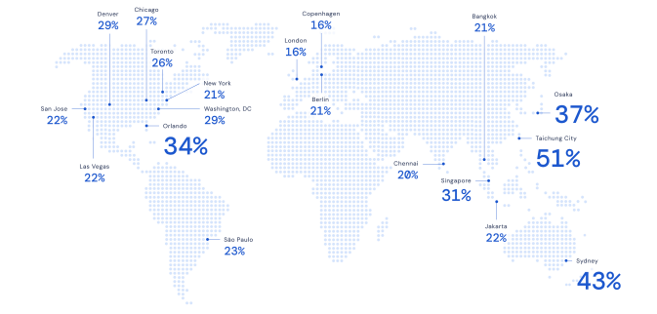
ETA Prediction with Graph Neural Networks in Google Maps
INTRODUCTION:
Google Maps estimated time-of-arrival (ETA) prediction improvements for several world regions, when using our deployed graph neural network-based estimator. Numbers represent relative reduction in negative ETA outcomes compared to the prior approach used in production. A negative ETA outcome occurs when the ETA error from the observed travel duration is over some threshold and acts as a measure of accuracy.

Slide 3
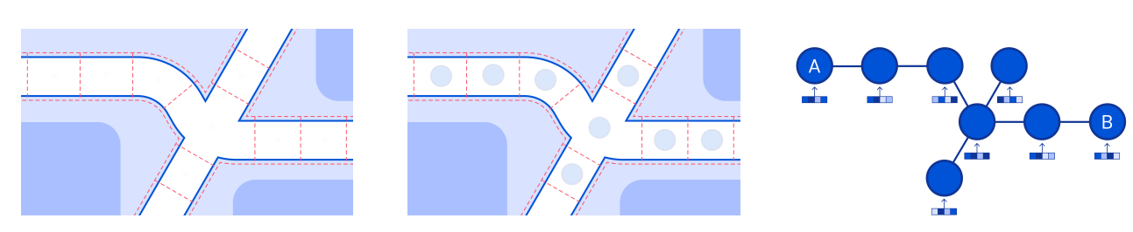
ETA Prediction with Graph Neural Networks in Google Maps
METHOD:
In this section, we describe our travel time prediction problem in the context of arrival time estimation. We also provide the technical details of the GNN models that we used for this problem, including their architecture and training details. The key components of our method are models that operate on networks of route segments in order to leverage their structure, and predict travel times for multiple time horizons into the future, in order to provide end users with more accurate ETAstheir architecture and training details. The key components of our method are models that operate on networks of route segments in order to leverage their structure, and predict travel times for multiple time horizons into the future, in order to provide end users with more accurate ETAs.

